Slide 1
Big Mountain Ticket Pricing Analysis

Slide 2
Problem Statement: How can Big Mountain select a better ticket price before the start of next ski season, by utilizing data from 330 other resorts, and by comparing its own facilities to other resorts. In addition, Big Mountain will look to increase efficiencies and cut costs across the resort, and generate at least an additional $1.54M to cover the increased operating costs for the new ski lift.
-Data file from Alesha Eisen. Target certain metrics from the data file to support an increased ticket price.
-Total ski runs, total chair lifts, total skiable area (acres), total snow making acreage, etc…
-Data file contains 27 different metrics that Big Mountain can compare to.
-Looking at the current facilities of Big Mountain, and comparing those to other similar resorts will show what kind of price increase can be expected.

Slide 3
Key findings and recommendation:
-For many of the highly relevant criteria - vertical drop, snow making area, total chairs, fast quads, runs, longest run, skiable terrain, Big mountain is in the top half or higher compared to all other resorts.
-Adding a run, increasing total vertical drop by 150 ft, and adding a chair gives Big Mountain a baseline ability to increase tickets by 92 cents.
-I recommend that Big Mountain increases ticket prices by a minimum 5$ to capture ~$8m in additional gross revenue

Slide 4
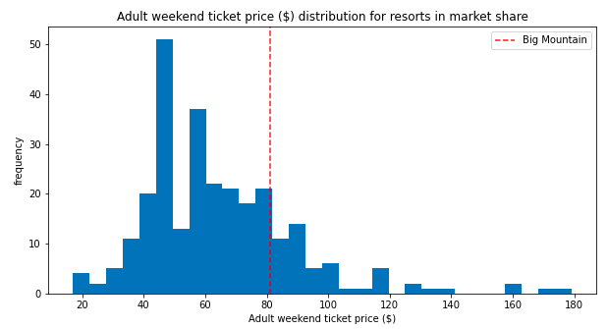
Modeling Results
Big Mountain ticket price in relation to all other resorts in the data set:

Slide 5
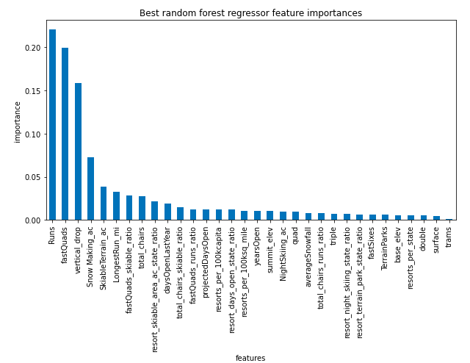
Random Forest Regressor
This graph portrays the features that the model found with most correlation to price charged. Runs, fast quads, vertical drop, and snow making acreage are the top 4 categories

Slide 6
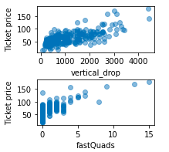
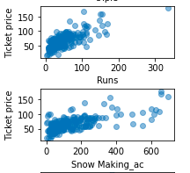
Scatter plots to show correlation:
Vertical drop and fast quads have a high correlation to ticket price
Runs and snow making acreage are also highly correlated

Slide 7
Conclusion:
Given the great position that Big Mountain is in with current facilities, I suggest that ticket price be raised by at least $5. With the new lift in operation, the mountain needs to generate an additional $1.54m each season to cover the increased costs of operation. Adding 1 run, increasing the vertical drop by 150 ft, and the new chair lift justifies a $0.92 cent increase in ticket price per the model. I propose increasing the ticket price by $5 to generate an additional $8.75m in gross revenue - this will more than cover the increased operations cost and will provide financing for future upgrades/improvements to the resort.

